Slide 1
INSPIRATION
BY:LAUREN H PENA

Slide 2
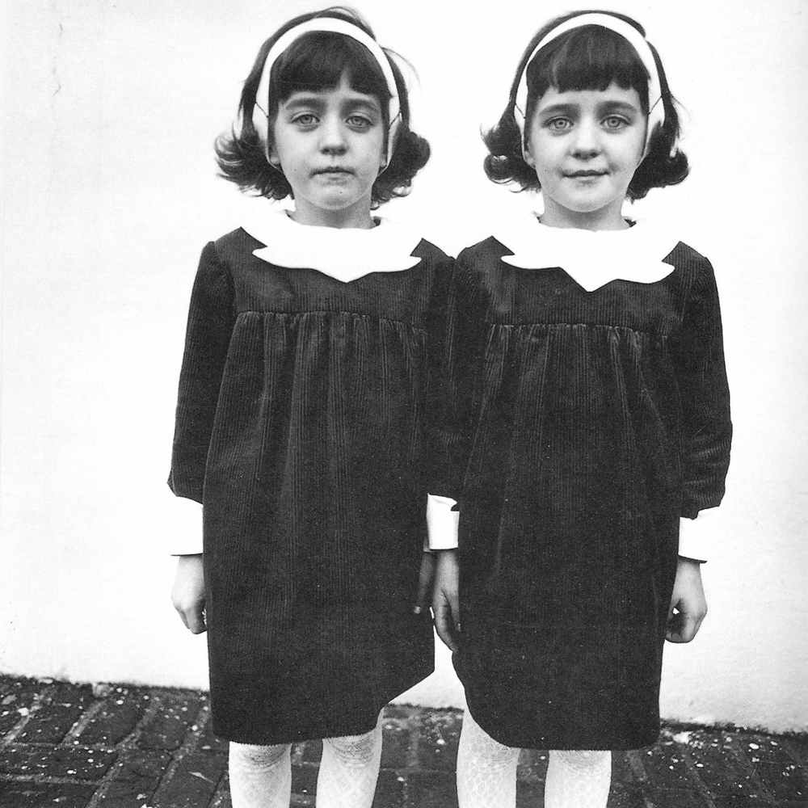
Diane Arbus
I like how these photos are mysterious and vintage looking.

Slide 3
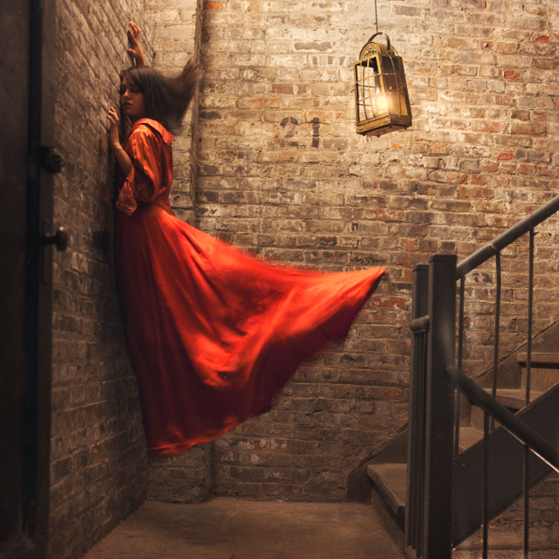
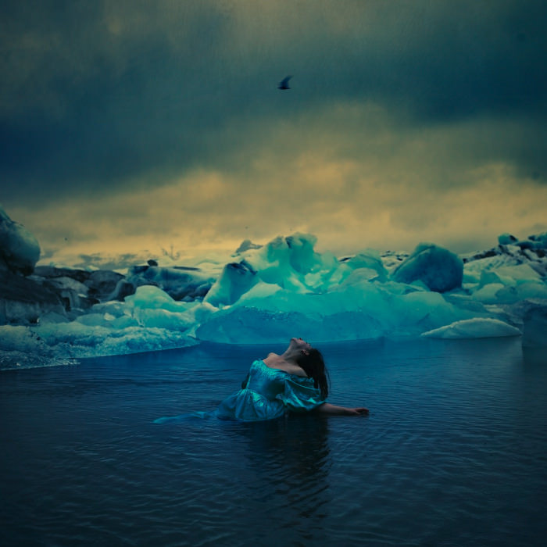
Brooke Shaden
These photos inspire, by the editing and some parts of the photographs look like there apart of paintings.

Slide 4
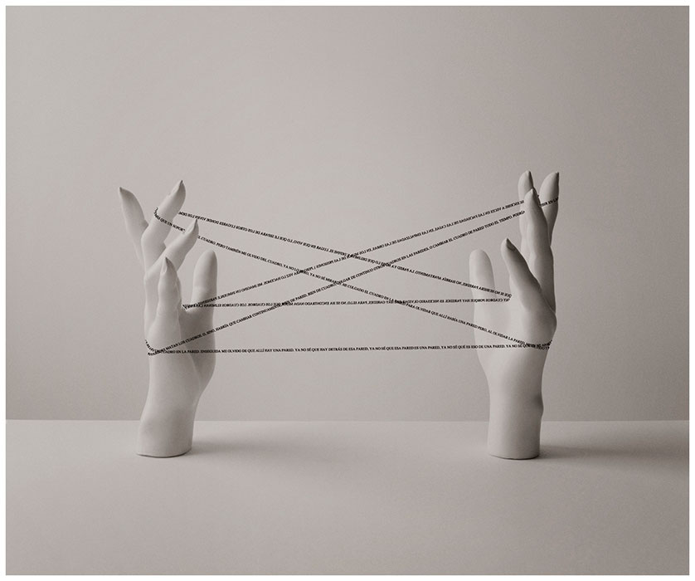
Chema Madoz
I like how like Madoz made these photos monochromatic and he displayed them to be clean.

Slide 5
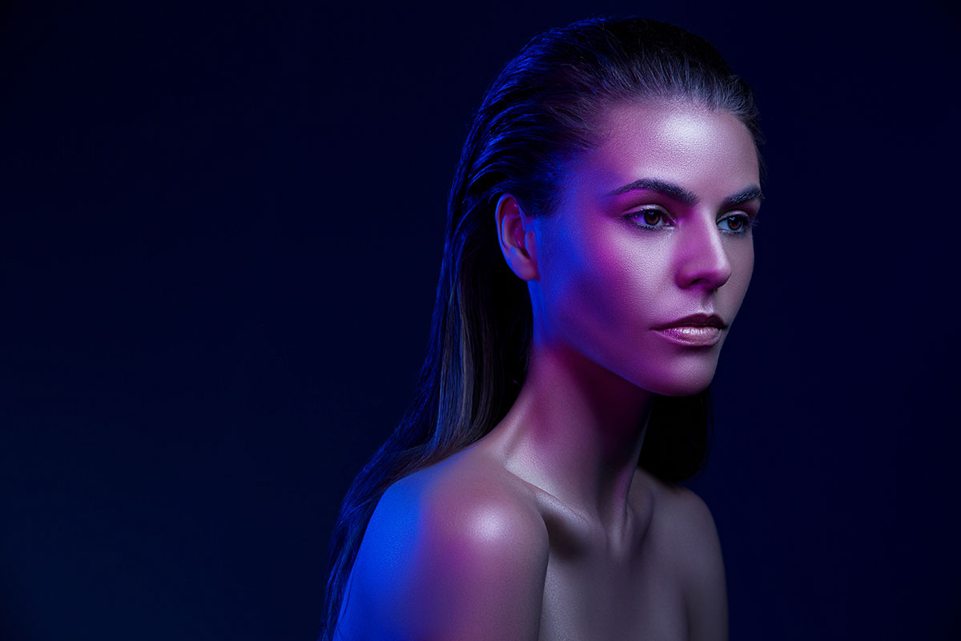
Lindsay Adler
These photos inspire me because they are very bright and vibrant.

Slide 6
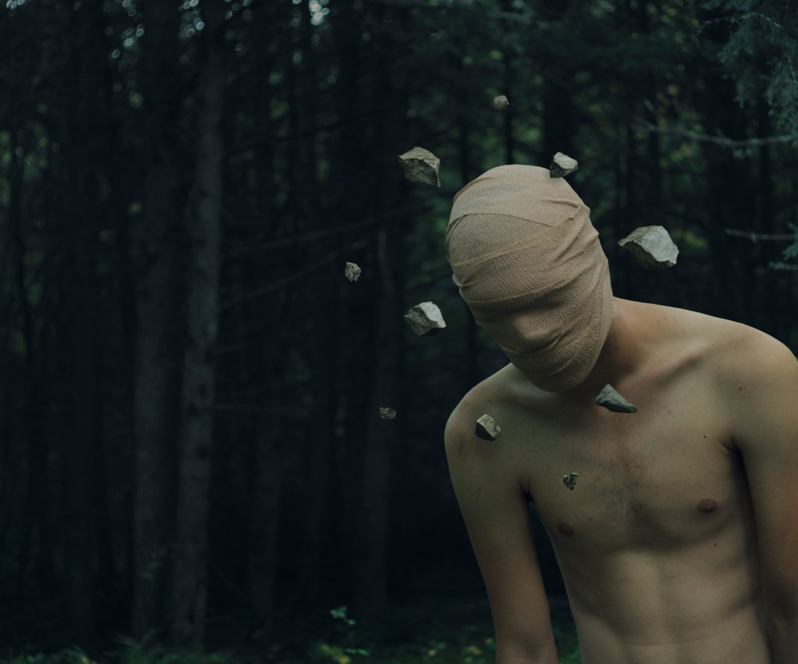
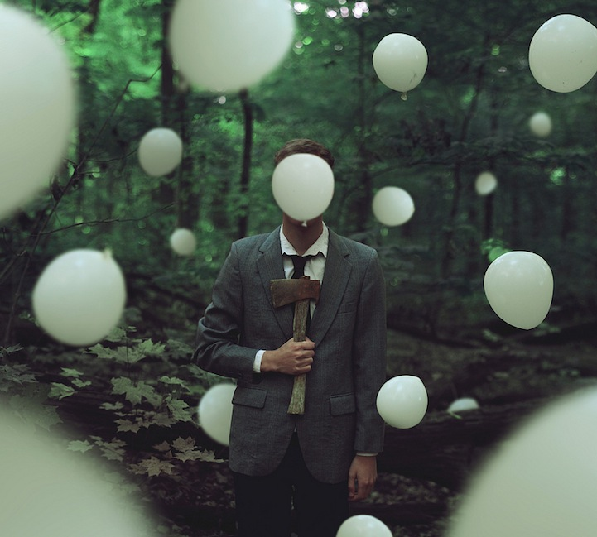
Kyle Thompson
I like the levitation and the props along with the sceneary.

Slide 7
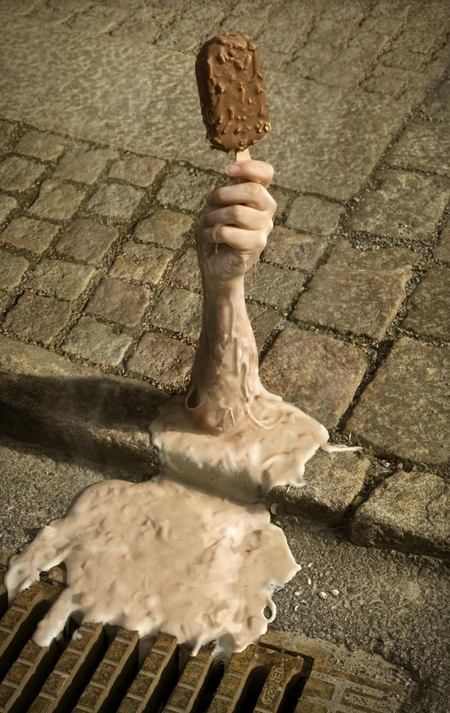
Erik Johansson
I like how things are drifting away

